Slide 1
The Generations of Computer History
Microsoft office clipart

Slide 2
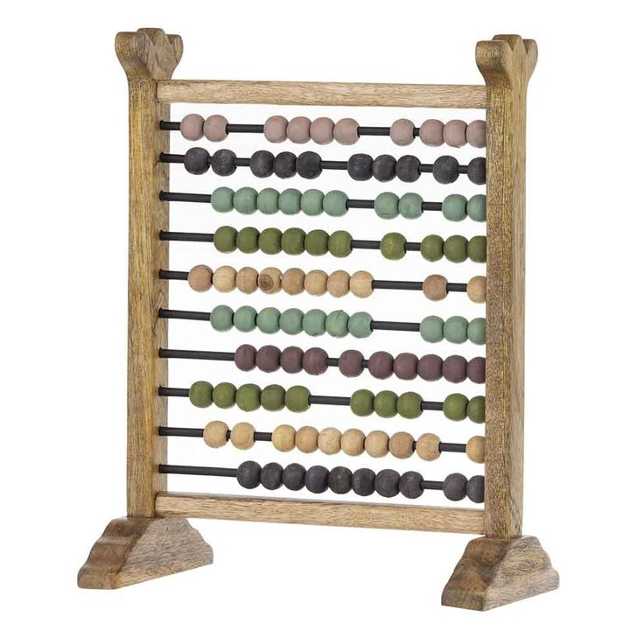
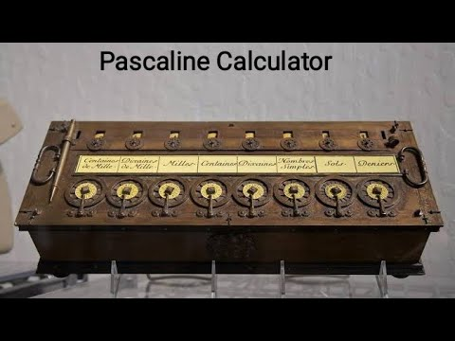
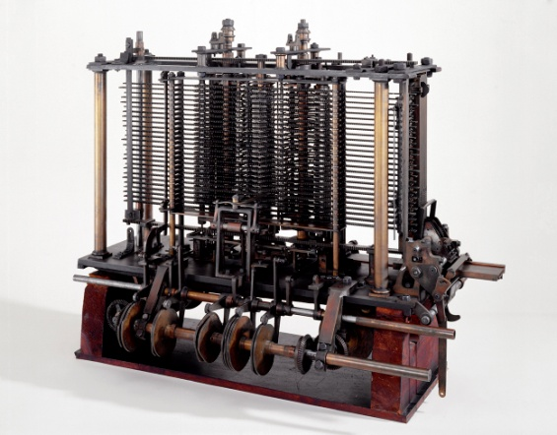
ZEROETH GENERATION
Man used his fingers, ropes, beads, bones, pebbles and other objects for counting.
Abacus, Pascaline, Difference & Analytical engines
Electricity was not yet invented

Slide 3
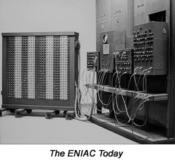
1st Generation(1946-58) vacuum tubes (ENIAC)
America got its first glimpse of ENIAC in 1946.
ENIAC was built by Eckert and Mauchly.
ENIAC was announced on February 14th,1946.
It was first introduced to the Army.
*Electronic Numerical Integrator And Computer
The ENIAC museum online

Slide 4
Early Electronic Computers and The Computer Generations
The First Generation (1951 to 1959)
Grace
Hopper
J. Presper Eckert
Clifford Berry
John Atanasoff
Howard Aiken
John von Neumann
John Mauchly
Notes:
3
Early Electronic Computers and
The First Generation (1951 to 1959)
Early Electronic Computers
- Atanasoff and Berry develop the ABC--first special purpose,
electronic digital computer (1939)
- Aiken and IBM completed Mark I computer in 1944
- Mauchly and Eckert developed ENIAC (completed 1945)
See photograph in textbook
- John von Neumann--stored-program concept
The First Generation (1951 to 1959)
- Used vacuum tubes
- Programmed by machine language
- IBM announced first commercial computer, the IBM 701, in 1953
- Used punched cards for data and instructions
- Magnetic tape introduced in 1957

Slide 5
First Generation Computers 1951-1959
The First Generation (1951 to 1959)
- Used vacuum tubes
- Programmed by machine language
- IBM announced first commercial computer, the IBM 701, in 1953
- Used punched cards for data and instructions
- Magnetic tape introduced in 1957
.

Slide 6
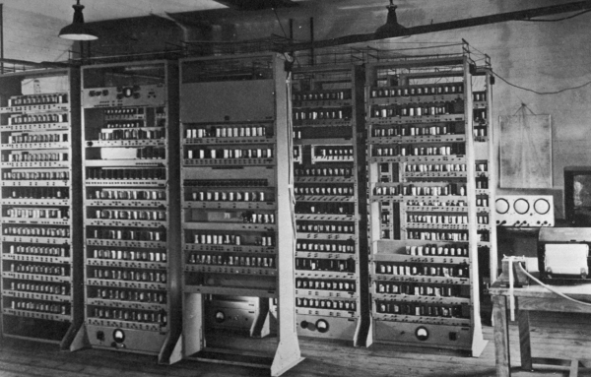
1st Generation (con’t)
In 1949 Wilkes assembled the EDSAC.
Mark 1 Computer used Williams memory in 1949.
Forrester installed magnetic memory in 1953.
The 701 was shipped in 1953.
The EDSAC
*Electronic Delay Storage Automatic Calculator
www.dcs.warwick.ac.uk/~edsac/

Slide 7


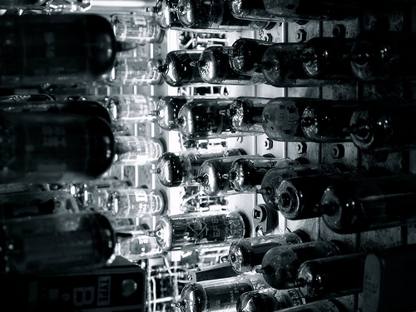
Different examples of vacuum tubes
www.enclylepedia.com
www.encylepedia.com
www.flickr.com

Slide 8
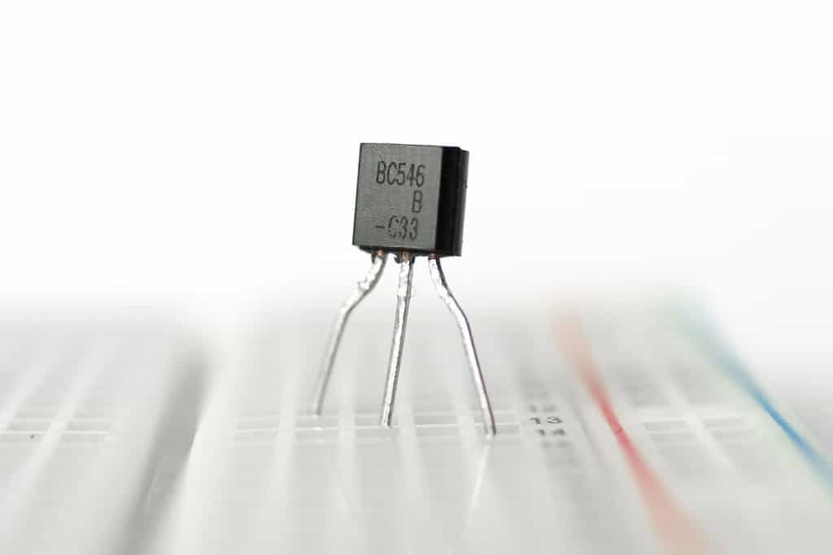
Second Generation 1959-1963
The Second Generation (1959 to 1963)
- Used transistors
- Memory composed of small magnetic cores
- Magnetic disks and magnetic tape used for secondary storage
- Communications possible
- New concepts
Multiprogramming
Parallel processing
- Input and output devices very slow
.

Slide 9
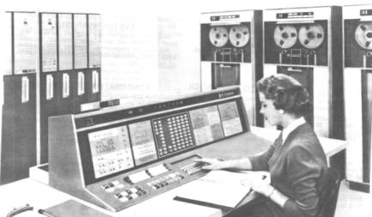
2nd Generation (1959-64) Transistors
IBM’s 7000 series,the first transistorized computers.
IBM had an 81.2% share of the computer market.
IBM announced the System/360.
www.piercefuller.com

Slide 10
Third Generation 1963-1975
These computers used integrated circuits on silicon chips.
They were characterized with high-level programming languages which required logic such as BASIC, Pascal, C, COBOL, and Fortran

Slide 11
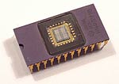
3rd Generation (1965-70) Integrated Circuits
nobelprize.org/educational_games/physics/integrated_circuit/history/index.html
Digital Equipment Corp. introduced the PDP-8.
The PDP-8 was the 1st commercially successful mini-computer.
PARC invented the personal computer graphical user interface.
*Programmed Data Processor

Slide 12
Fourth Generation 1975-Today
These computers use microprocessor chips.
Object-Oriented Programming (OOP) Languages such as Visual Basic, and JAVA are characteristic of this computer generation.

Slide 13
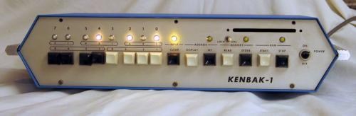

4th Generation(1971-present) Microprocessor
Kenbak-1, 1st personal computer.
Ray Tomlinson sent the first e-mail.
IBM invented the 8 pins Floppy disk.
1986 Pixar is founded
www.piercefuller.com
Microsoft office clipart
www.computerhistor.com

Slide 14
5th Generation Still Being Developed
Natural Language
This language is designed to give people a more human connection with computers.
Uses multi-media has also defined this generation.
There is a great deal of “bundled software” with this generation.

Slide 15
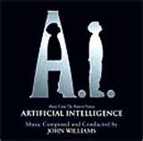
5th Generation (present and beyond) Artificial Intelligence
A.I. is trying to comprehend intelligence.
A.I is still being created today.
Alan Turing developed the Turing Test in 1950.
www.essortment.com

Slide 16
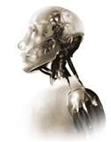
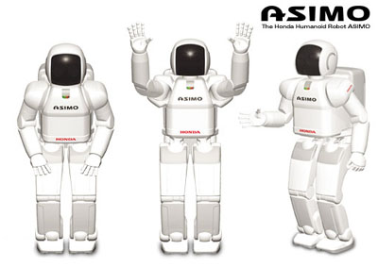
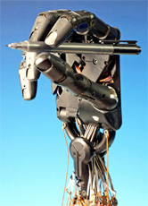
Artificial Intelligence
www.diseno-art.com
www.goasi.com
www.engadget.com

Slide 17
Internet Citations
Computer History Museum. Computers. www.computerhistory.org.2006. October 23, 2008
Artificial Intelligence.www.essotment.com.2005. November.13,2008
Microsoft office clipart
www.encylepedia.com.2008, November 14,2008
www.flicker.com.2008. november14,2008
www.gosai.com. 2008. Nov ,14 2008
www.engadget.com. 2008 .Nov,14 2008

